Slide 1
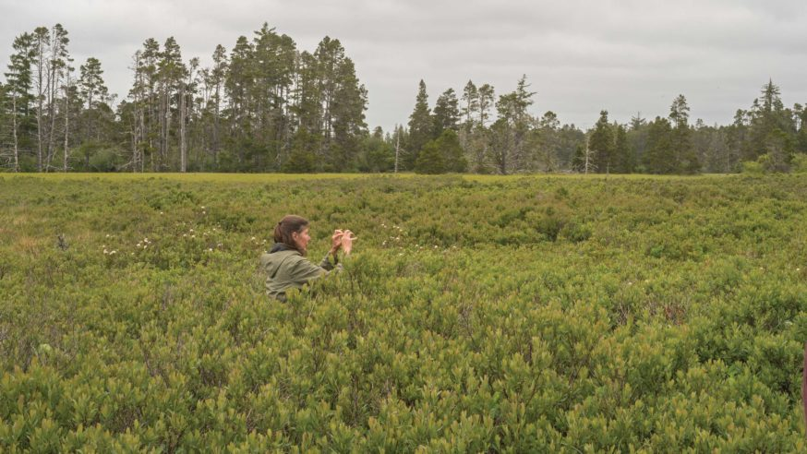
Land and Fire Co-exist
Traditional Ecological Knowledge teaches us how fire is an important tool used to manage land and restore resources.

Slide 2
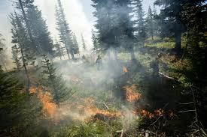
Presence of Fire in History
Coast Salish people have been using fire to manage the land for thousands of years. (Myth of the Boy and fire)
Early explores of the west refer to the prairies as being modified by fire.
2011 - Euphoria Ridge meadow, charcoal was detected and produced a calibrated radio carbon date range of 3380 to 3260 BP

Slide 3
Historical evidence of active land management
The use of fire was one tool used to enhance natural resource production and boost productivity of terrestrial landscape. This way of intensification shaped broader changes in Coast Salish society.

Slide 4
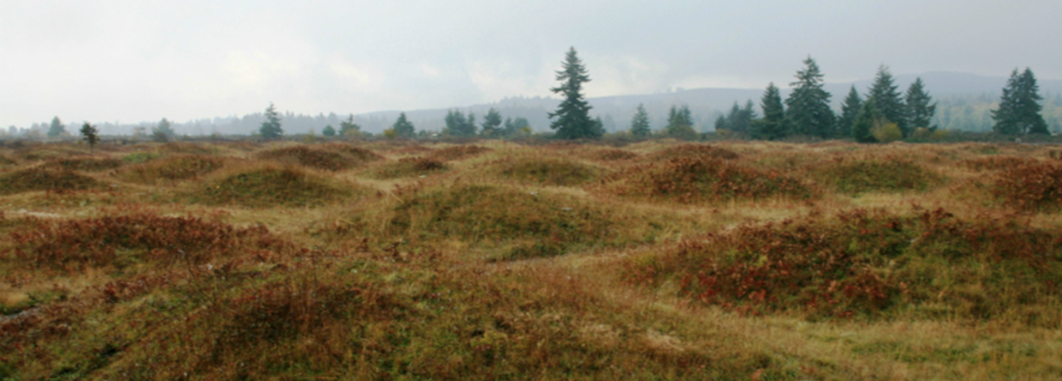
Effects of Fire on the Landscape
manage the landscape for wild game
intensify wild plant foods
Prevent catastrophic fires from destroying surrounding forests and villages
Controlled fire created “yards” and “corridors” for hunting and for increasing browse for wild game
Nutritious grasses and forbs that follow fire events in during these prescribed burns in meadows and open forest patches attracted animals.
These patchwork mosaics created by fire, like the edge effect caused by natural disturbances, increase local biodiversity
http://www.dnr.wa.gov/MimaMounds

Slide 5
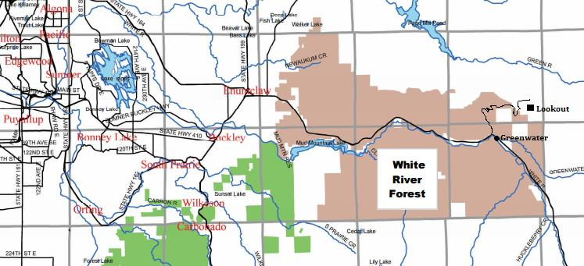
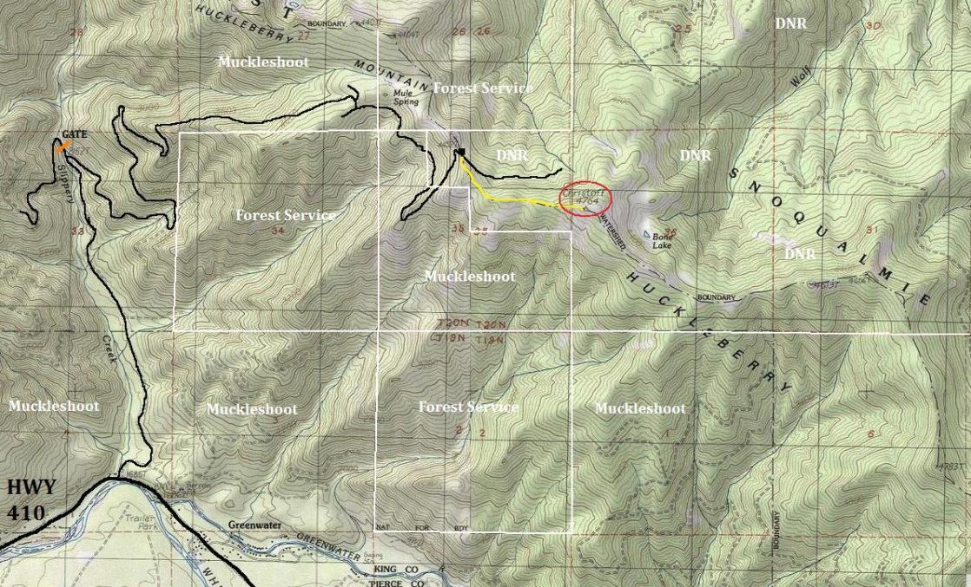
Huckleberry Mountain
Needs to be managed or the Huckleberry’s will get crowed out by growing forest canopy.
2006 study- Prescribed burning is not currently being considered for treatment purposes in the four units in Government Meadows primarily because the trees are too small to effectively support a broadcast burn (Starkovich, Personal Communication).

Slide 6
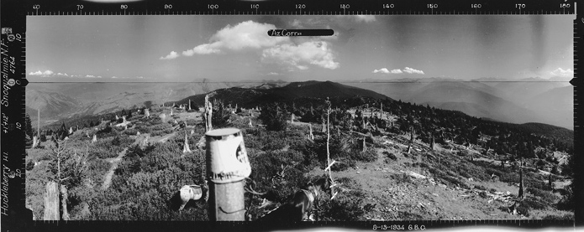
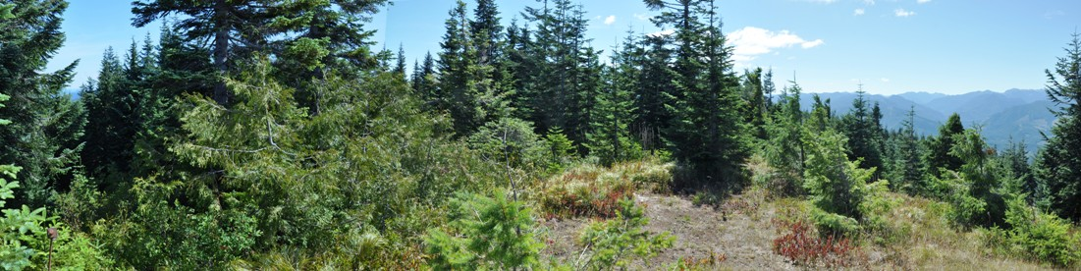
Huckleberry Mountain – Tribal owned land
1934 - SE
2015 – SE

Slide 7
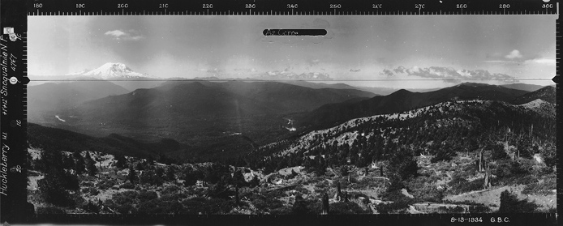
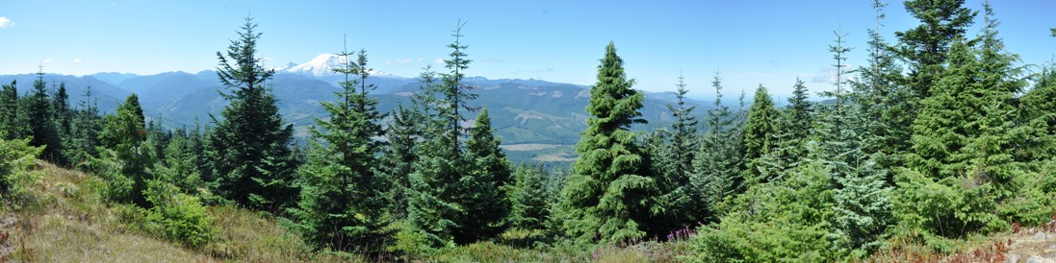
Huckleberry Mountain – Tribal owned land
1934 - SW
2015 – SW

Slide 8
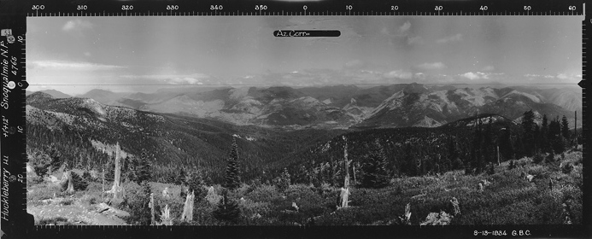
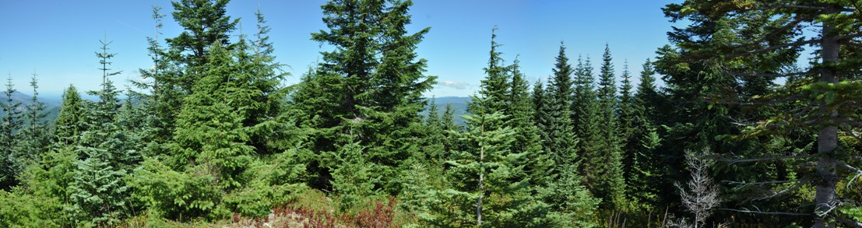
Huckleberry Mountain – Tribal owned land
1934 - NW
2015 – NW

Slide 9
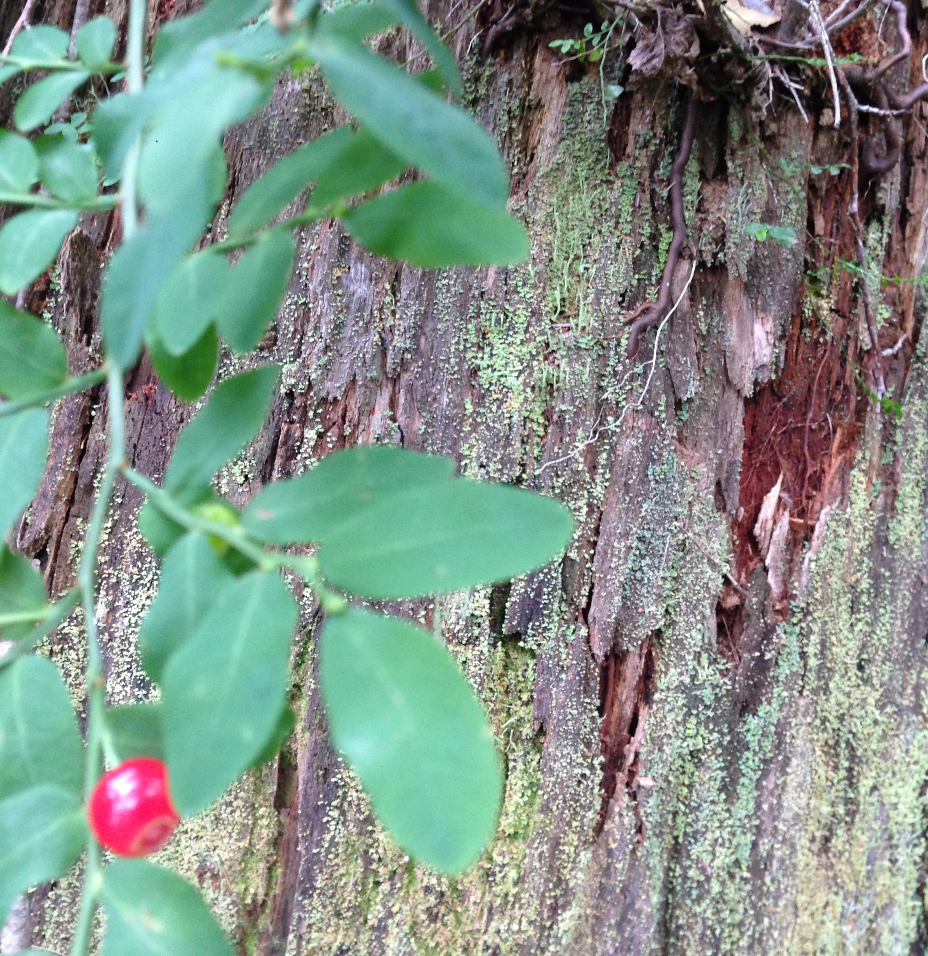
Methods to manage (Mountain balds, prairies or even clear cut areas)
it is also conceivable that the combination of thinning and prescription fire would prove to be synergistic regarding the stimulation of shrub understory.
future projects on the Mt. Baker-Snoqualmie National Forest, where prescribed burning could potentially be implemented as one of the treatment options to enhance productivity of big huckleberry.

Slide 10
Prescribed Burn Approval Process
The Department of Natural Resources is responsible for regulating air quality emissions from forestry burning.
2. A DNR Air Quality Specialist in Olympia evaluates conditions and determines whether to grant approval for proposed burning.
3. That decision is posted on the DNR website — www.dnr.wa.gov
4. The smoke approval is still subject to review by the Prescribed Fire Manager at the burn location to assure the necessary resources and conditions for a successful mission are present. In many cases, data collected at the burn location is fed to the National Weather Service whose meteorologists prepare a site-specific (“spot”) weather forecast to provide detailed information. Using this and actual fire behavior observations, ongoing decisions are made about how much of the approved acreage should be burned each day. At any point, the Fire Manager can choose to suspend burning operations until more favorable conditions return.

Slide 11
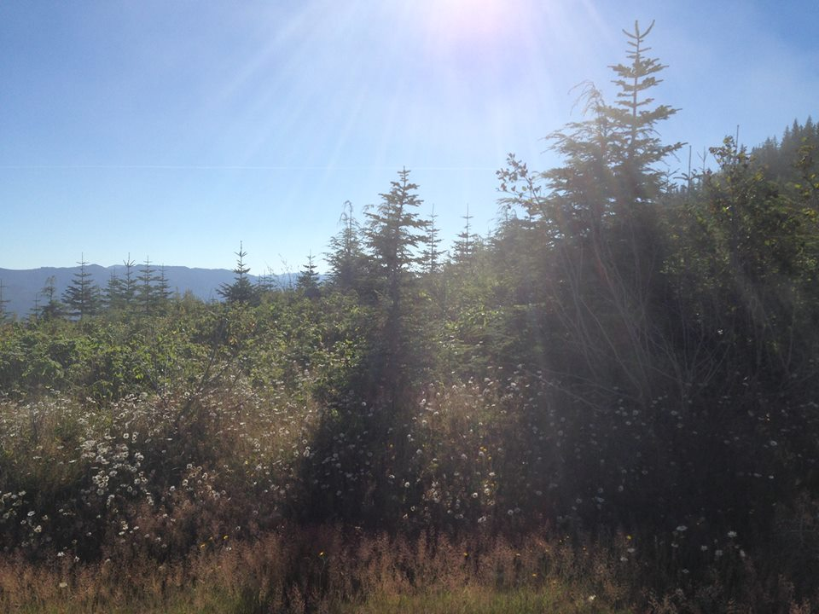
Conclusion: Land and fire can co-exist and we need to preserve and implement prescribed burning as a land management tool
“Modern fire suppression is negatively affecting culturally important resources. Establishing the connection between fire and resource management would make it possible for the Tribe to file for a burn plan and begin actively managing the area with prescribed burns once again.” (Grier, Goodman-Elgar, and Jones. 2012)

Slide 12
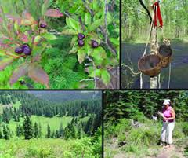
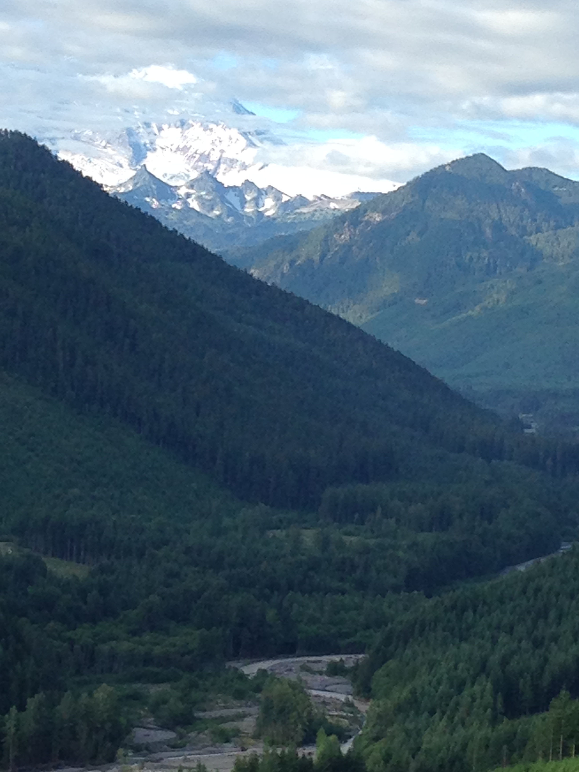
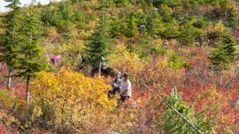

Slide 13
Bibliography
Boyd, Robert T and Leopold, Estella. (1999) Indians, Fire, and the Land in the Pacific Northwest, An Ecological History of Old Prairies Areas in Southwestern Washington. 1st ed. Corvallis, Or.: Oregon State UP. Print.
Derr, K. , Grier, C. , Goodman-Elgar, M. , and Jones , J. (2012). Intensifying with Fire: Floral Resource Use and Landscape Management by the Pre-contact Coast Salish of Southwestern British Columbia. Retrieved from: ProQuest Dissertations and Theses. Web.
http://www.dnr.wa.gov/MimaMounds
Huckleberry Mountain Lookout (Christoff Lookout). http://www.willhiteweb.com/washington_fire_lookouts/christoff/huckleberry_mountain_344.htm
Walker, Roger F., Robert M. Fecko, Wesley B. Frederick, Watkins W. Miller, and Dale W. Johnson. (2012) "Influences of Thinning, Chipping, and Fire on Understory Vegetation in a Sierran Mixed Conifer Stand." Journal of Sustainable Forestry 31.6: 493-517. Print.
Laura Potash Martin, Joyce LeCompte-Mastenbrook, Warren KingGeorge, and Tracy Fuentes. 2008. Management & Monitoring Plan for the Enhancement of Big Huckleberry (Vaccinium membranaceum) in Government Meadows, Mt. Baker-Snoqualmie National Forest. USDA Forest Service, Snoqualmie Ranger District, North Bend, WA

Slide 14
Bibliography
Laura Potash Martin, Joyce LeCompte-Mastenbrook, Warren KingGeorge, and Tracy Fuentes. 2008. Management & Monitoring Plan for the Enhancement of Big Huckleberry (Vaccinium membranaceum) in Government Meadows, Mt. Baker-Snoqualmie National Forest. USDA Forest Service, Snoqualmie Ranger District, North Bend, WA
Minore, Don., Smart, Alan W, Dubrasich, Michael E, and Pacific Northwest Forest Range Experiment Station. Huckleberry Ecology and Management Research in the Pacific Northwest. Portland, Or.]: U.S. Dept. of Agriculture, Forest Service, Pacific Northwest Forest and Range Experiment Station, 1979. General Technical Report PNW ; 93. Web
Northwest Treaty Tribes. (Oct. 11, 2016) TULALIP PRESERVES HUCKLEBERRY RESOURCE. Retrieved from: http://nwtreatytribes.org/tulalip-preserves-huckleberry-resource/
Martin, Adam. (Oct. 6th, 2016) BRINGING FIRE BACK ONTO THE QUINAULT INDIAN NATION. The Center for Natural Lands Management. Retrieved from: http://www.washingtonnature.org/fieldnotes/moses-prairie-burn

Slide 15
Bibliography
USFS. Fire and Aviation / Fire Management Today. 8/24/2015. Retrieved from: http://www.fs.fed.us/fire/fmt/

